Slide 1



SCHOOL OF ENGINEERING TECHNOLOGY
E-SMART DASH
TEAM MEMBERS:
SMRUTHI JHA (2401730081)
&
ANSH KUMAR(2401730126)
Under the supervision of:
Internal supervisor:MS.JYOTI KATARI
SMRUTHI JHA & ANSH KUMAR
E-SMART DASH
ENSI152
PAGE 1/11

Slide 2

SCHOOL OF ENGINEERING TECHNOLOGY
INTRODUCTION
Web-based interactive dashboard
Converts Excel data into dynamic, interactive visuals
AI-driven trend analysis for deeper insights
Enhanced data visualization for better decision-making
Simplifies complex data for accessibility and action
SMRUTHI JHA & ANSH KUMAR
E-Smart Dash
ENSI152
PAGE 2/11

Slide 3


SCHOOL OF ENGINEERING TECHNOLOGY
OBJECTIVES
Develop a flexible dashboard that supports any Excel file.
Enable interactive data visualization..
Utilize AI for trend detection and insights.
Provide export and notification features
SMRUTHI JHA & ANSH KUMAR
E-SMART DASH
ENSI152
PAGE 3/11

Slide 4

SCHOOL OF ENGINEERING TECHNOLOGY
PROBLEM STATEMENT
Many users struggle with analyzing raw data.
Existing tools require manual configuration.
Lack of AI-driven insights in traditional dashboards.
No simple, automated solution for data visualization.
SMRUTHI JHA & ANSH KUMAR
E-SMART DASH
ENSI152
PAGE 4/11

Slide 5
SCHOOL OF ENGINEERING TECHNOLOGY
METHODOLOGY
RESPONSIVE DESIGN
BACKEND
VISUALIZATION
PDF REPORT GENERATION
AI TREND DETECTION
Flask for data processing and API integration.
CSS Styling,
Live Clock,
Modal Usage
Plotly, Chart.js for dynamic charts.
Library Used: jsPDF
Linear regression for insights.
SMRUTHI JHA & ANSH KUMAR
E-SMART DASH
ENSI152
PAGE 5/11

Slide 6
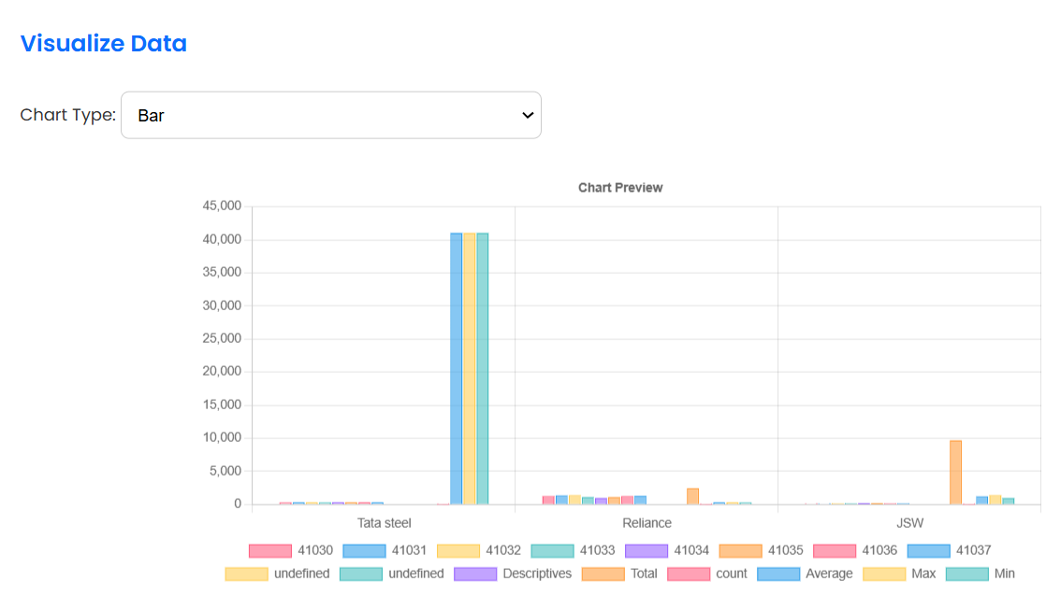
SCHOOL OF ENGINEERING TECHNOLOGY
EXPECTED OUTCOME
1.
A fully functional, user-friendly dashboard.
2.
Automatic visualization of uploaded data.
3.
AI-based trend detection for deeper insights
4.
Live clock for tracking the time.
SMRUTHI JHA & ANSH KUMAR
E-SMART DASH
ENSI152
PAGE 6/11

Slide 7


SCHOOL OF ENGINEERING TECHNOLOGY
APPLICATIONS
Finance & Budgeting: Analyzing income and expenses.
Education: Student performance tracking.
Business Analytics: Sales and revenue forecasting.
Healthcare: Patient data trend analysis.
Research & Development: Statistical insights.
SMRUTHI JHA & ANSH KUMAR
E-SMART DASH
ENSI152
PAGE 7/11

Slide 8
SCHOOL OF ENGINEERING TECHNOLOGY
CONCLUSION / FUTURE WORK
eSmart Dash integrates file upload, dynamic visualizations, AI-based insights, and PDF export in one interactive platform.
It simplifies data analysis for users with no coding background.
The dashboard promotes informed decision-making through visual and trend-based data interpretation.
Integrate advanced ML models for predictive analytics.
Enable real-time data support via APIs or live feeds.
Improve mobile compatibility and responsive design.
Allow custom dashboard themes and layout personalization.
Add secure user login and personal data storage features.
SMRUTHI JHA & ANSH KUMAR
E-SMART DASH
ENSI152
PAGE 9/11

Slide 9

SCHOOL OF ENGINEERING TECHNOLOGY
THANK YOU
SMRUTHI JHA & ANSH KUMAR
E-SMART DASH
ENSI152
PAGE 11/11

